Slide 1
Self-analysis techniques (SWOT & TOWS)

Slide 2

Self-analysis techniques:

Slide 3
Self-analysis techniques
The organization has to avoid pre-conceived beliefs or gray areas and instead focus on real-life contexts.
SWOT is designed to facilitate a realistic, fact-based, data-driven look at the strengths and weaknesses of an organization and initiatives.
Its key purpose is to identify the strategies that will create
- a firm specific business model
- that will best align an organization’s resources and capabilities to the requirements of the environment in which the firm operates.

Slide 4
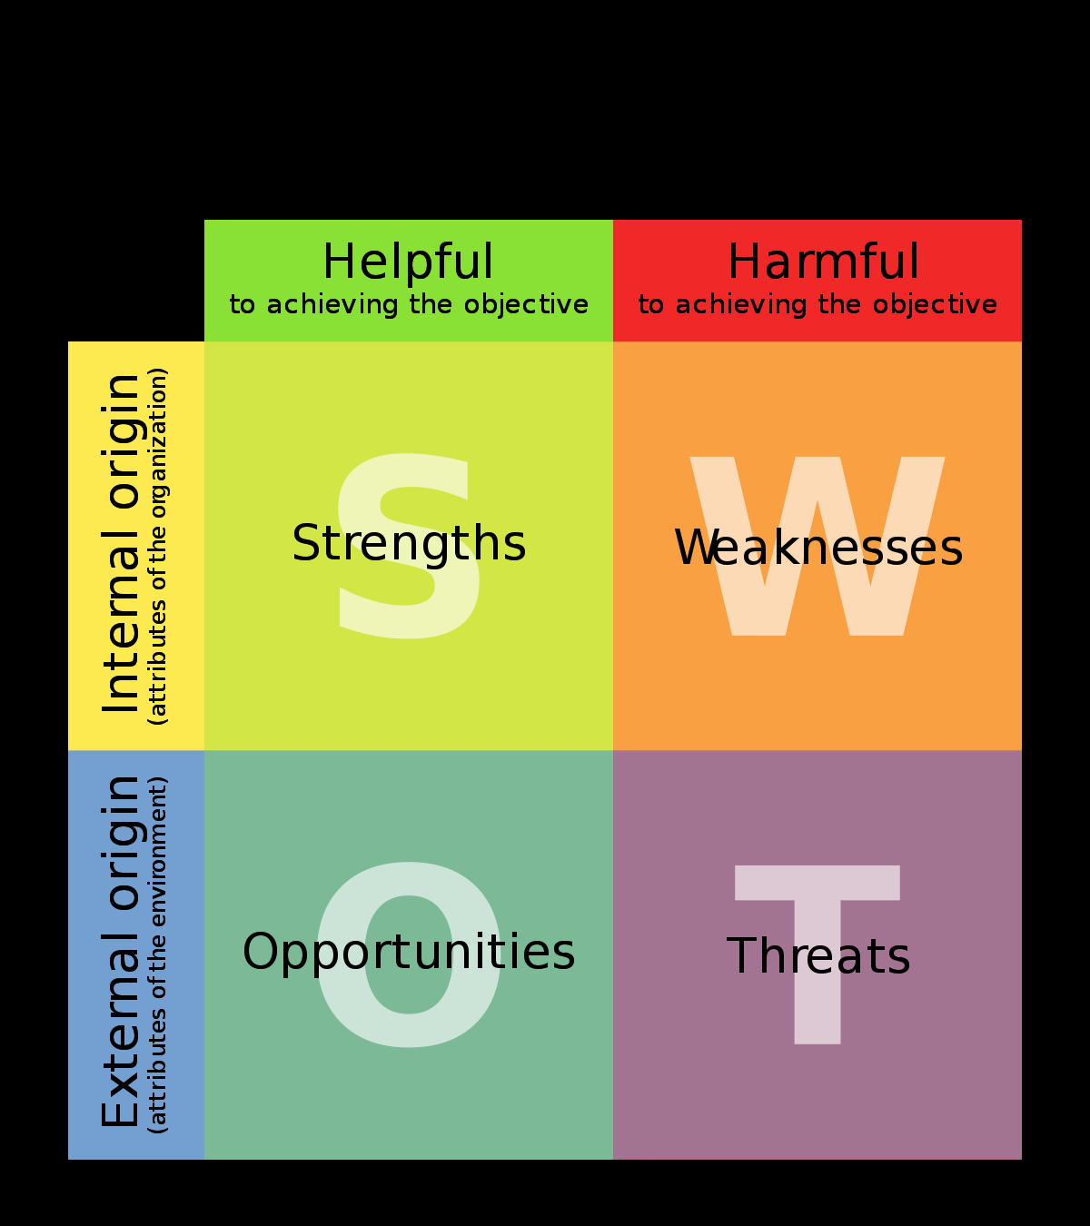

Slide 5
Strengths (internal, positive factors)
Characteristics of the business or individual that give it an advantage over others in the industry.
Positive tangible and intangible attributes, internal to an organization or individual.
Beneficial aspects of the organization or the capabilities of an organization, process capabilities, financial resources, products and services, customer goodwill and brand loyalty.

Slide 6
Weaknesses (internal, negative factors)
Characteristics that place the firm or individual at a disadvantage relative to others.
Detract the organization from its ability to attain the core goal and influence its growth.
Weaknesses are the factors which do not meet the standards we feel they should meet. However, weaknesses are controllable. They must be minimized and eliminated.

Slide 7
Opportunities (External, positive factors
Are external attractive factors that represent reasons your business is likely to prosper.
Chances to make greater profits in the environment -External attractive factors that represent the reason for an organization to exist & develop.
Arise when an organization can take benefit of conditions in its environment to plan and execute strategies that enable it to become more profitable.
Organization should be careful and recognize the opportunities and grasp them whenever they arise.

Slide 8
Threats (external, negative factors)
External elements in the environment that could cause trouble for the business -External factors, beyond an organization’s control.
Arise when conditions in external environment jeopardize the reliability and profitability of the organization’s business.

Slide 9
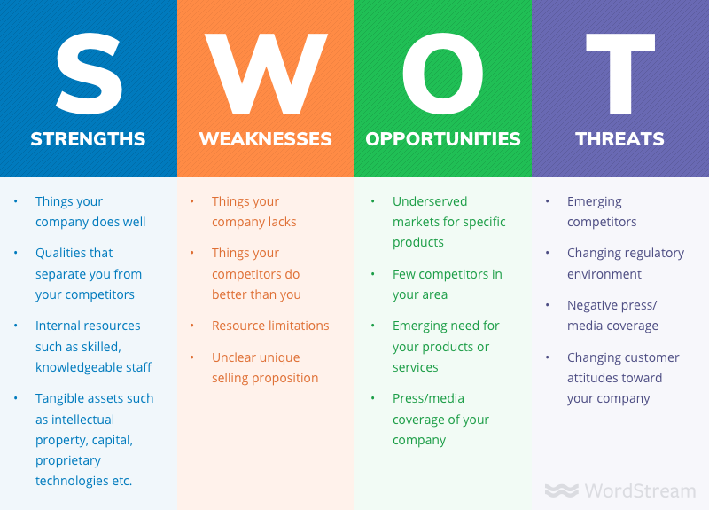

Slide 10

To help decision makers share and compare ideas.
•To bring a clearer common purpose and understanding of factors for success.
To organize the important factors linked to success and failure in the business world.
To help individual or organization to understand their strengths and weaknesses.
•It promotes strategic thinking

Slide 11

Who needs SWOT Analysis?
SWOT Analysis is required for / during...
- Decision Making
-Product Launch
-Product Evaluation
-Competitor Evaluation
-Problem solving
-Strategic Planning
-Personal Development Planning
-Workshop Sessions
-Changing Jobs

Slide 12
If all you're trying to do is essentially the same thing as your rivals, then it's unlikely that you'll be very successful.
Michael Porter

Slide 13
SWOT Vs Tows
A SWOT analysis helps in summarizing critical data by categorizing – Strengths, Weaknesses, Opportunities and threats
SWOT analyses can be interesting, but what should you do with the resulting information?
SWOT doesn’t show the relationships between the different factors and categories.

Slide 14
Tows analysis
TOWS is extension of SWOT
Understanding a strategic planning process
TOWS is effective way to brainstorm specific strategies to address the results of your initial SWOT investigation.

Slide 15
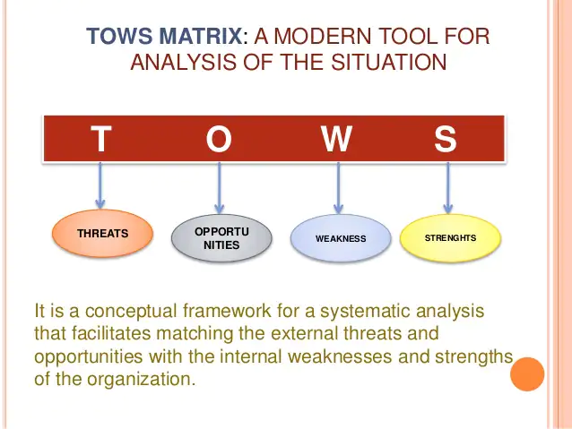

Slide 16
Strategic planning process
Changing how things work is central to it
Identifying ‘hows’ but for that identifying ‘whats’ is critical
A SWOT analysis helps in summarizing critical data by categorizing – Strengths, Weaknesses, Opportunities and threats
A TOWS analysis helps us devise strategies from a SWOT.

Slide 17
How is tows carried out?
Run SWOT analysis
Collect Information
Lay out the TOWS grid

Slide 18
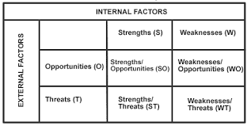
Tows analysis

Slide 19
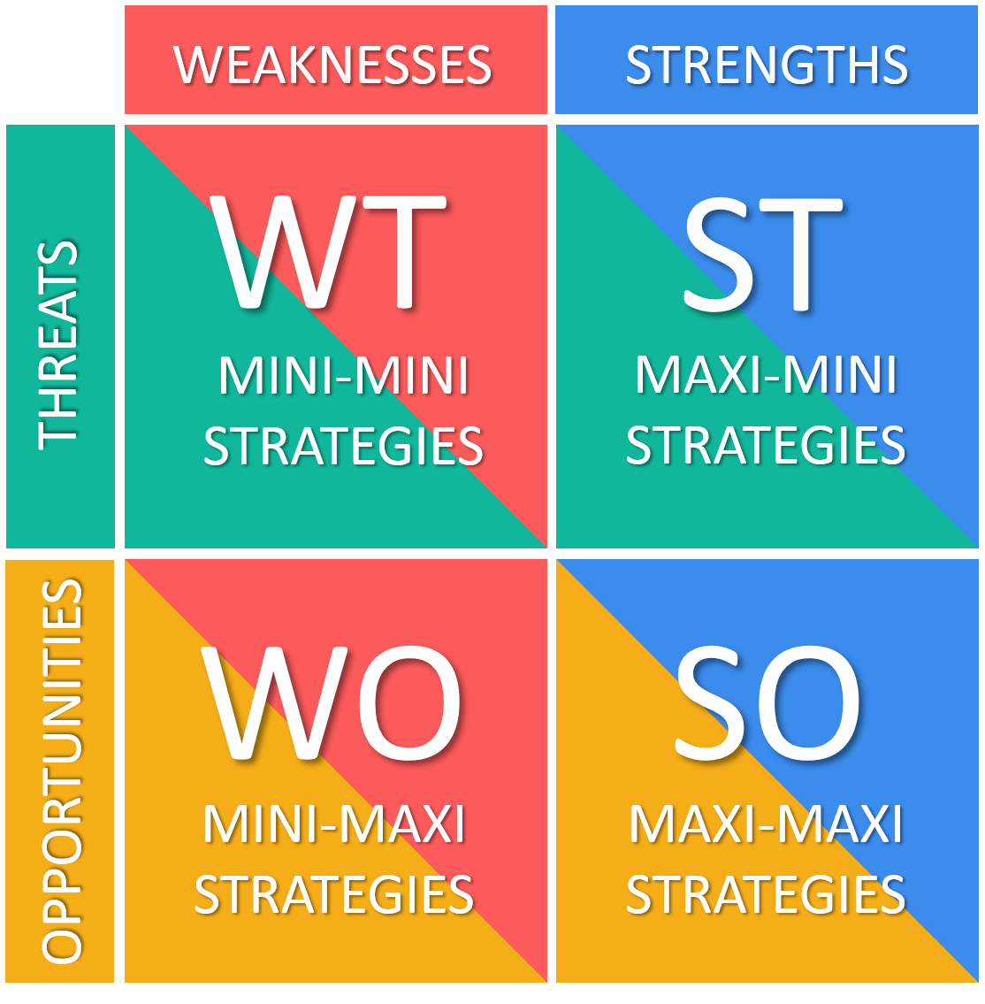
Create a chart where your internal pieces (Strengths and Weaknesses) intersect with the external aspects (Opportunities and Threats).

Slide 20
The strategic options identified
Maxi – maxi strategies – Use strengths to exploit opportunities
Maxi – mini strategies – Use strengths to reduce the impact of threats
Mini – maxi strategies – Use opportunities to overcome weaknesses
Mini –Mini strategies – minimise weaknesses and avoid threats

Slide 21
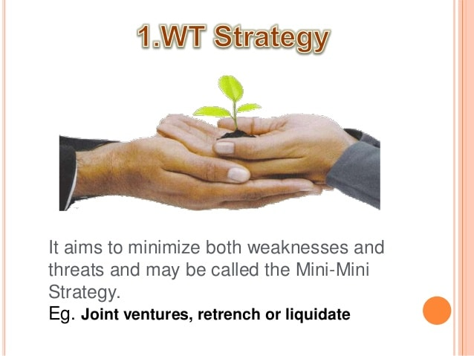

Slide 22
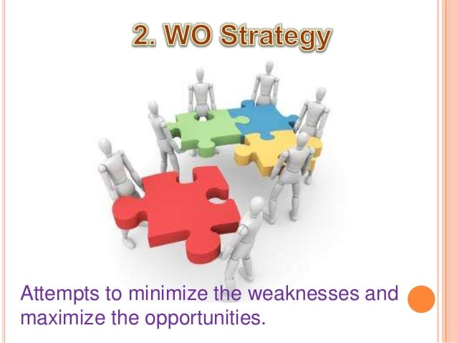

Slide 23
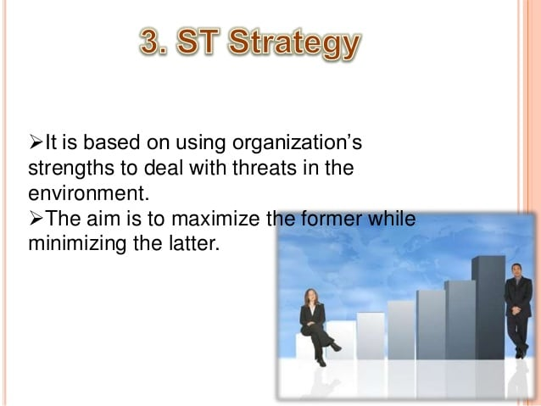

Slide 24
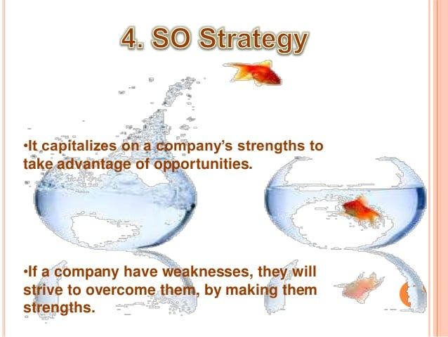

Slide 25
Outcomes of Tows Analysis
Reduce any identified Threats
Capitalize and take advantage of Opportunities
Work around and overcome Weaknesses
Make the most and exploit Strengths

Slide 26
ADVANTAGES
Easy and simple to use
Identifies internal and external factors and establishes a connection between them.
Works well with other types of analysis to provide a deep insight to organizational health
DISADVANTAGES
The analysis can be subjective
Exposes the analysis to bias
Can get complicated

Slide 27
Example
https://youtu.be/H4cNDnuWUK0

Slide 28


Slide 29
TOWS
T – Threats
O - Opportunities
W – Weaknesses
S –
Strengths
What is TOWS ?
Threats Opportunities Weaknesses Strengths
TOWS can help you explore opportunities and counter threats with the help of your Strengths and Weaknesses.
Strategize and set goals using the TOWS framework
Notes:
Facilitator Guide
Type of Screen : Lecture and Activity
Recommended Duration: 60 minutes
Aim and objective of this screen : To help students understand with an example how SWOT analysis can help them balance with Threats and Opportunities
Say: TOWS and SWOT are two different arrangements of the words Strengths, Weaknesses, Opportunities and Threats.
Say: Threats and opportunities belong to the external environment. Weaknesses and strengths are a part of the internal environment.
Say : TOWS appears to be just the reverse order of SWOT but it helps in generating strategic options. When we use it, we are trying to visualise how best we can get the advantage of the opportunities (O) open to us. At the same time, if our focus is on the threats (T) then we would be able to reduce the impact of weaknesses and protect ourselves against the threats.
Say : A detailed analysis of SWOT will help you to strategically use the external environment to your advantage and also identify some suitable options available.
Do: Students will get a research time of 15 minutes to find out how successful people and organisations have strategized to survive successfully.
Do: Open house for students and lecturer to discuss their findings

Slide 30
TOWS and its relevance in the VUCA world

Slide 31
We live in a VUCA world.
Our world is
VOLATILE
UNCERTAIN
COMPLEX
AMBIGUOUS
VUCA stands for a constantly changing business landscape wherein lies their O and T.

Slide 32
Volatile –
As in a world which keeps changing very fast. We are increasingly connected with the world and any change in one corner of this globe affects the other parts.
Effect of Brexit on the global market
Impact of Covid 19
Taliban capture of Afghanistan
Uncertain---
As in the effect of emerging technology on the existing business modes.
How taxi industry has been impacted by Uber
Air bnb has affected hotel industry etc

Slide 33
Complex–
As in different cultural / regulatory existences in different parts of the globe
In India the effect of GST on businesses.
Ambiguous –
As in today’s world there are a lot of things which keep changing leaving people with unanswered questions.

Slide 34

In such a world it is very important to have the ability and skills to survive.

Slide 35
STORY TIME

Slide 36

Once upon a time there lived a little boy. He had lost his father when he was only five years old
He had one younger brother and 1 younger sister. To become the ‘breadwinner’ of the family his mother went out to do some small works.

Slide 37

At the age of 7, his responsibility was to take care of his younger brother and sister by cooking food and feeding them.

Slide 38

At the age of 12, he quit school under some circumstances. At the age of 13, he left home and went out to do garden work and earn some money. After some days that garden owner threw him out of that place.

Slide 39


At the age of 17, he worked in 4 to 5 places but he was shunned out of every place by saying he doesn’t know how to work and he can’t do anything.
At the age of 22, he worked as a bus conductor and in a railway department. even there he was thrown out

Slide 40


After that, he got married. After marriage he had children. The wife and children also said he doesn’t know how to work and left him and went. Where you see there is the only failure for him. He missed his children so much, so he tried to convince his wife and bring her back, but she refused. So he decided to kidnap his daughter and he failed in that.

Slide 41
He worked as an insurance agent, again failed. Next worked in the bakery, he was thrown out from there. He worked in various resorts and left. He worked as a painter and left. Not only here, wherever he went they said you can’t do anything and threw him out.

Slide 42
Like this, he reached 65 years. He even received retirement. And one day he sat and thought, what happened in my life, in my life there is the only failure. He thought “My life is a losing streak”. What is left? Why should I be still alive? What more is there to lose? And he tried committing suicide. He even failed there.

Slide 43
He sat under a tree and started thinking about what should I do? I failed many times in my life.. Then he decided to do something that nobody has done before. As an old man, he made a major decision and started working on a big goal with great enthusiasm. His failures became his foundations. He was determined to do a great job, that no one had done earlier at his age. He focused and started working hard for it.

Slide 44


He was rejected several times and finally, one day he met a business man who took interest in his unique recipe and then there was no turning back.

Slide 45
And When he got 88 years he became one of the largest billionaires in America.
Can you tell the name of this person and his company ?

Slide 46

KFC
And…..this man’s name was
Colonel Harland Sanders
There are 20,000 outlets in 120 countries across the world. His annual income is 23 billion dollars.

Slide 47

Motivation in real life

Slide 48
MOTIVATION has been defined as
THE NEEDS, DESIRES, WANTS TO DO SOMETHING
THE DRIVING FORCE TO DO SOMETHING
AN INNER FORCE THAT COMPELS YOU TO TAKE ACTION
Notes:
Facilitator Guide
Type of Screen : Lecture
Recommended Duration: 15 minutes
Aim and objective of this screen : Discuss the Topic.
Say: In the last class, I told you the story of Colonel Harland Sanders and all of you presented the topic of Motivation through various interesting modes of communication.
Say: On the slide you can see few definitions of Motivation.
Do: Ask three students to read the definitions loudly.
Elicit responses
Say: Scientists define motivation as your general willingness to do something. It is the set of psychological forces that compel you to take action.
Do: Play a 2minute 47 seconds video on Maslow’s Hierarchy of Needs. https://www.youtube.com/watch?v=O-4ithG_07Q.
Ask: How do you relate the needs in relation to your life ?
Say: These are age old definitions which are accepted by everyone but let me also ask you
What is motivation according to you ?
When do you feel motivated ?
How do you stay motivated ?
Do you always feel equally motivated ?

Slide 49

CHALLENGE
PUT ON YOUR THINKING CAPS
AND COME UP WITH A DIFFERENT DEFINITION OF MOTIVATION IN NOT MORE THAN TWELVE WORDS
CREATIVE TIME : 10 MINUTES
Notes:
Facilitator Guide
Type of Screen : Activity
Recommended Duration: 10 minutes
Aim and objective of this screen : Introduce the activity.
Say: All the definitions are nice but now let me throw a challenge to you. In ten minutes time come up with a different definition of motivation in not more than twelve words.
Say: After ten minutes you will write the definition you have created on a piece of paper and paste it on the soft board/ chart paper. Mention your name.

Slide 50
What is motivation
A process of arousing and sustaining goal-directed behavior
It accounts for individual’s:
Intensity (how hard a person tries)
Direction (towards a beneficial goal)
Persistence (how long a person tries)

Slide 51
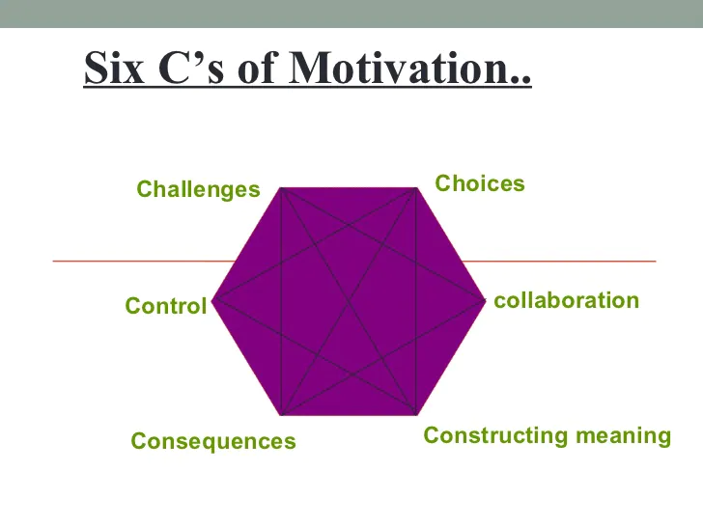

Slide 52
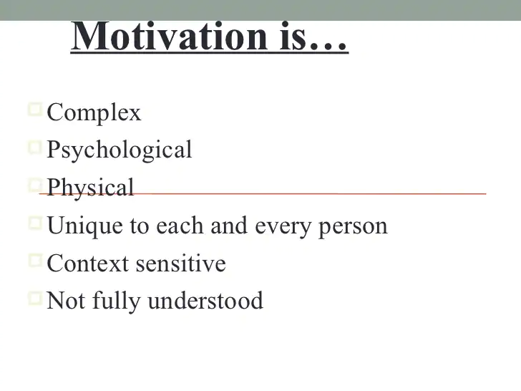

Slide 53
Abraham Maslow (1908-1970)
He was a psychologist and professor
An article in 1943 in a journal called Psychological Review
In 1954 he wrote a book called ‘Motivation and Personality’
He proposed a theory named Maslow’s hierarchy of needs

Slide 54
Abraham Maslow (1908-1970)
Our actions are motivated in order to achieve certain needs.
This theory is often portrayed in the shape of a pyramid with the largest, most fundamental needs at the bottom and the need for self actualization at the top.
The basic needs must be met before the individual is motivated for the next level needs.

Slide 55
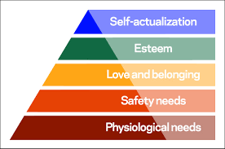
Maslow proposed that motivation is the result of a person's attempt at fulfilling five basic needs:

Slide 56
Maslow’s Hierarchy of Needs
MOST NEEDS HAVE TO DO WITH
SURVIVAL PHYSICALLY AND
PSYCHOLOGICALLY
(e.g. air, food, drink, shelter, clothing, warmth, sleep)
PHYSIOLOGICAL OR SURVIVAL NEEDS
Notes:
5

Slide 57
Maslow’s Hierarchy of Needs
Once an individual’s physiological needs are satisfied, the needs for security and safety become salient.
People want to experience order, predictability and control in their lives.
These needs can be fulfilled by the family and society
(e.g. schools, business, police and medical care).
SAFETY NEEDS
PHYSIOLOGICAL OR SURVIVAL NEEDS

Slide 58
Maslow’s Hierarchy of Needs
The third level of human needs is social and involves feelings of belongingness.
Belongingness, refers to a human emotional need for interpersonal relationships, affiliating, connectedness, and being part of a group.
LOVE, AFFECTION, AND
BELONGINGNESS NEEDS
SAFETY NEEDS
PHYSIOLOGICAL OR SURVIVAL NEEDS
Notes:
7

Slide 59
Maslow’s Hierarchy of Needs
The fourth level in Maslow’s hierarchy includes self-worth, accomplishment and respect.
ESTEEM NEEDS
LOVE, AFFECTION, AND
BELONGINGNESS NEEDS
SAFETY NEEDS
PHYSIOLOGICAL OR SURVIVAL NEEDS
Notes:
8

Slide 60
Maslow’s Hierarchy of Needs
NEED
FOR
SELF-
ACTUALIZATION
Self-actualization needs are the highest level in Maslow's hierarchy, and refer to the realization of a person's potential, self-fulfillment, seeking personal growth and peak experiences.
Notes:
9

Slide 61
Maslow’s Hierarchy of Needs
NEED
FOR
SELF-
ACTUALIZATION
MASLOW EMPHASIZES NEED FOR SELF
ACTUALIZATION IS
A HEALTHY INDIVIDUAL’S PRIME
MOTIVATION
SELF-ACTUALIZATION MEANS ACTUALIZING
ONE’S POTENTIAL BECOMING ALL ONE IS
CAPABLE OF BECOMING
Notes:
10

Slide 62
Maslow’s Hierarchy of Needs
ON THE WHOLE AN INDIVIDUAL
CANNOT SATISFY ANY LEVEL
UNLESS NEEDS BELOW ARE
SATISFIED
NEED
SELF-
ACTUALIZATION
ESTEEM NEEDS
LOVE, AFFECTION, AND
BELONGINGNESS NEEDS
SAFETY NEEDS
PHYSIOLOGICAL OR SURVIVAL NEEDS
Notes:
11

Slide 63
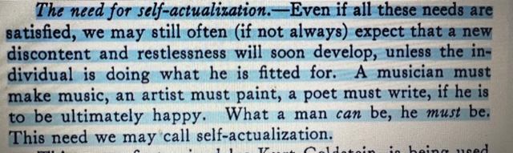

Slide 64
LINKS
https://www.youtube.com/watch?v=O-4ithG_07Q.

Slide 65
Maslow’s Hierarchy of Needs
In Organizations
Training,
Projects
Praise, Perks,
Bonuses
Socializing after work,
Sports, Activities
Swipe cards & codes, Receptionist, Health, security cameras
Good pay check, Snack bowl, Free lunch
Notes:
11

Slide 66

WHAT DO YOU THINK ABOUT THE SAYING ?
“It is easy to get motivated but it is difficult to stay
motivated for a long time….”
Notes:
Facilitator Guide
Type of Screen : Lecture and Activity
Recommended Duration: 5 minutes
Aim and objective of this screen : Understand the concept of Motivation.
Say: It is easy to get motivated but it is difficult to stay motivated for a long time.
Ask: What do you think about this saying ?
Do: Involve the students and get their response.

Slide 67


MANY PEOPLE CAN NEVER START A FITNESS PROGRAMME !!!
THERE ARE MANY WHO BEGIN AND ALSO DISCONTINUE AFTER SOME TIME. HAS IT HAPPENED TO YOU ?
Notes:
Facilitator Guide
Type of Screen : Lecture and discussion
Recommended Duration: 10 minutes
Aim and objective of this screen : Understand the concept of Motivation.
Ask: There are many people who can never manage to begin a fitness regime, weight loss programme, learn a new language/ technology,/ skill ? Or have you started and then discontinued ?
Do: Involve the students and get their response.
Ask: Is there any instance where you began doing something apart from your regular course/ work and continued without giving up ?
Do: Involve the students and get their response.

Slide 68
How do I REMAIN MOTIVATED throughout ?
Notes:
Facilitator Guide
Type of Screen : Lecture and Discussion
Recommended Duration: 7 minutes
Aim and objective of this screen : Understand the concept of Motivation
Ask: Let us find out how to stay motivated consistently ? Are there any way of staying motivated throughout ?
Do: Involve the students and get their response.
Ask: Is there any instance where you began doing something besides your regular course/ work and continued without giving up ?
Do: Involve the students and get their response.

Slide 69

Let us explore ways to remain motivated throughout.
Set small daily goals.
Decide a routine to achieve the small goals
Check your daily progress or failure
Keep relooking at your goals
Notes:
Facilitator Guide
Type of Screen : Lecture and Discussion
Recommended Duration: 7 minutes
Aim and objective of this screen : Understand the concept of Motivation
Ask: Together let us explore ways to remain motivated throughout.
Do: Ask the students to read the contents of the slides as you navigate.
Say: Often we discontinue because we set huge goals and think of a prolonged time. For example, I want to lose 10 Kgs. This kills motivation. It can be in one week I will lose 500 grams. Keep a daily tab on diet and workout. Check your weight on a daily basis, once you achieve that record your achievement and then move on to the next bit of the goal.
Do: Ask the students if they have ever done this. Share experiences.

